Slide 1

Hospital Triage AI Agent
Fast, accurate triage for better patient outcomes.

Slide 2
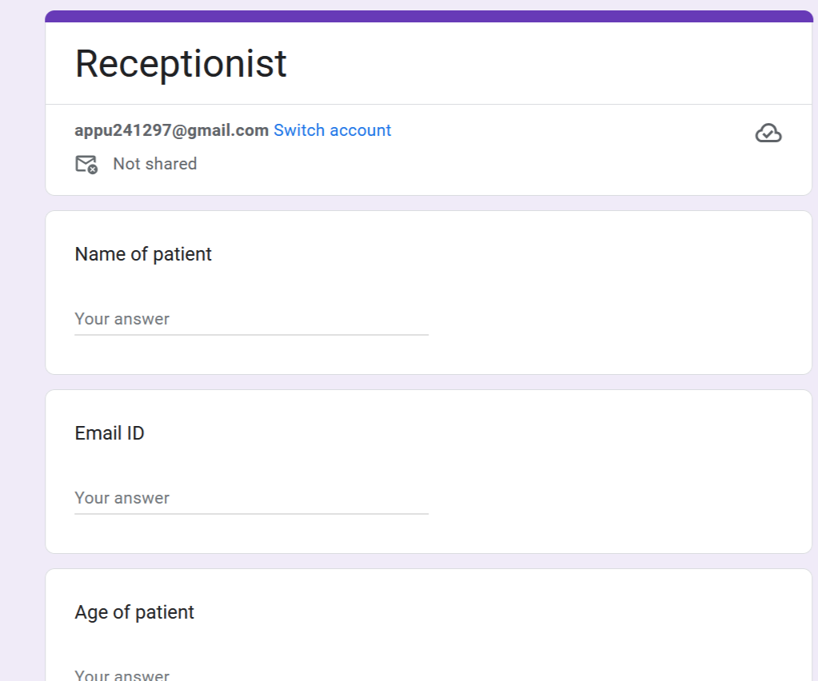
Data Collection Google Form

Slide 3
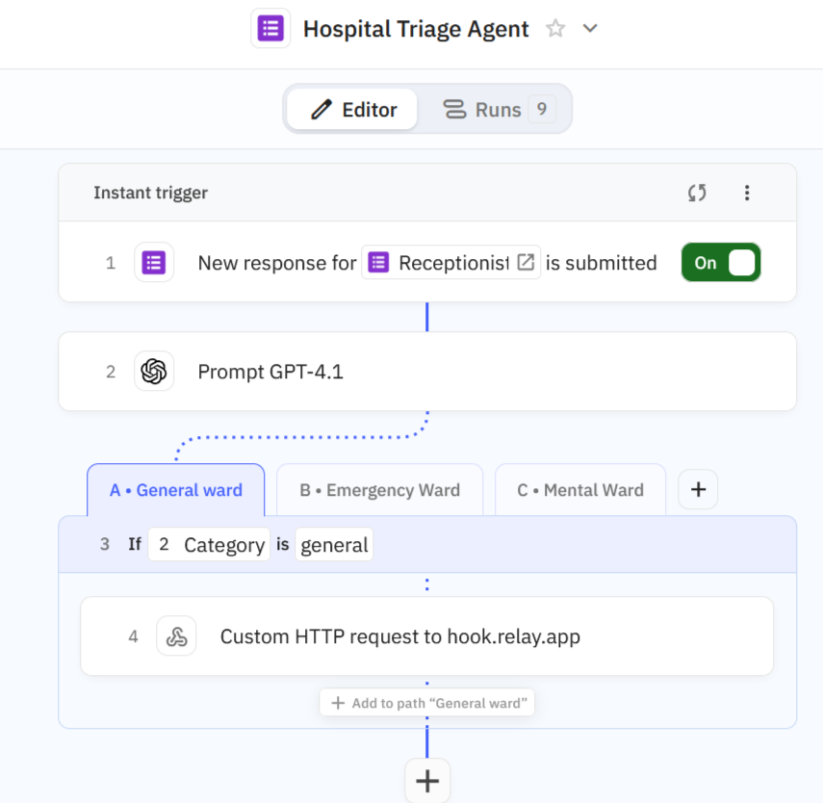
AGENT 1 -Hospital Triage Agent

Slide 4
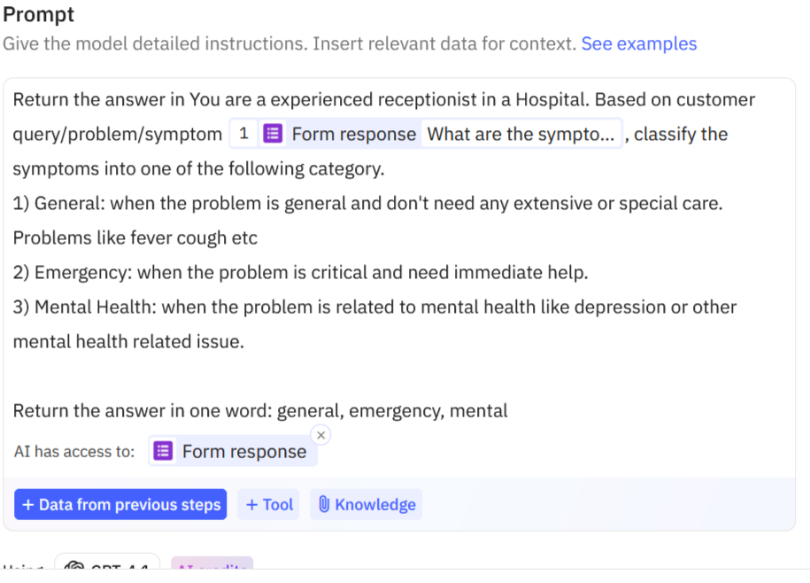
Segregation Prompt

Slide 5
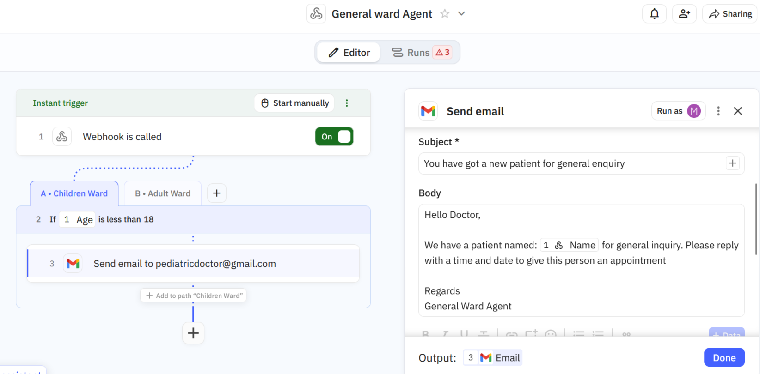
AGENT 2 - General Ward Agent
Segregate patients for children ward and adult ward based on age.

Slide 6
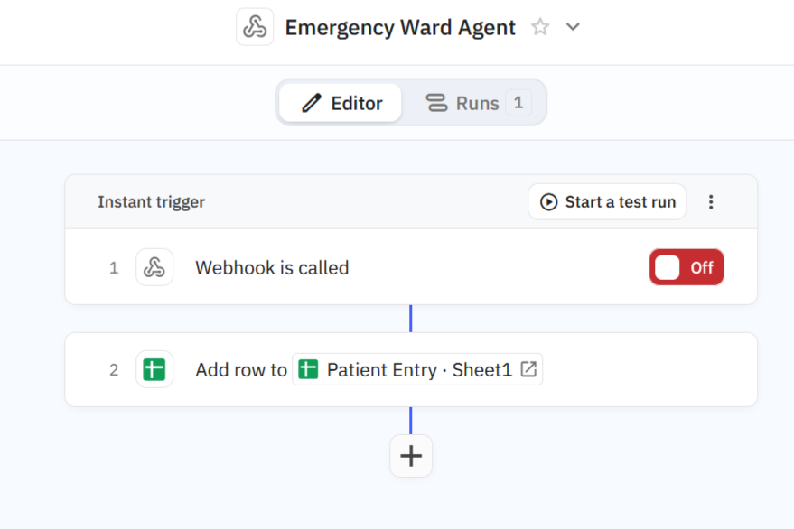
AGENT 3 - Emergency Ward Agent

Slide 7
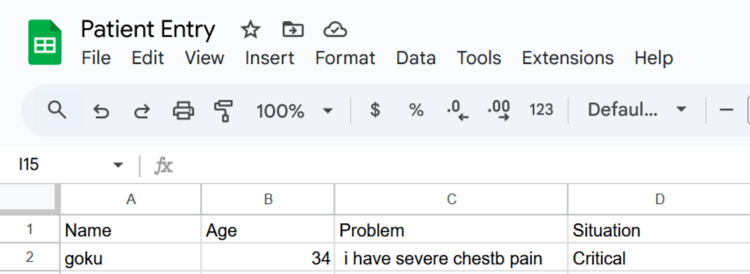
Patient Entry Excel Sheet (Emergency)
Lodging critical entries of emergency to take prompt action.

Slide 8
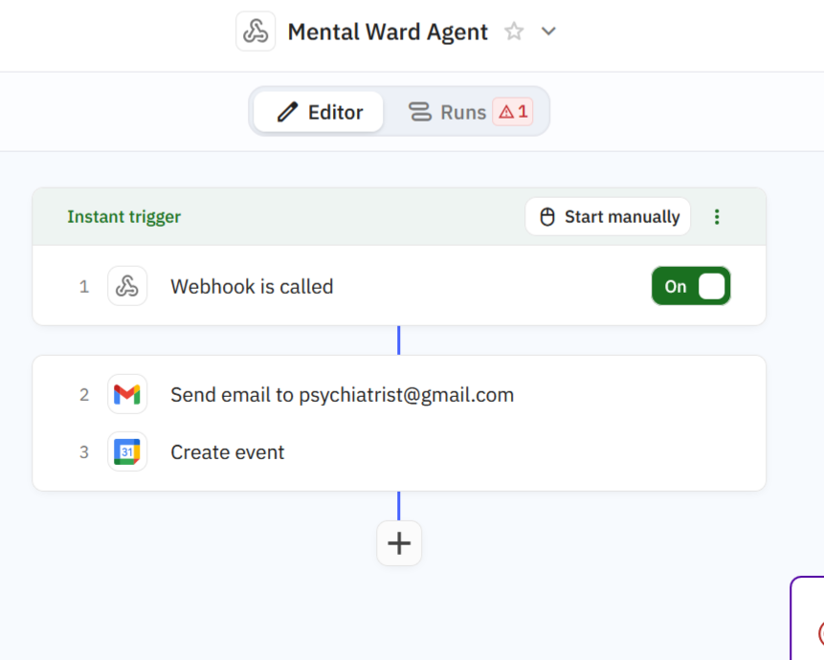
AGENT 4 – Mental Ward Agent
For patient with symptoms from mental disease.

Slide 9
Step 2 – AI Triage Classification (GPT-4.1)
Input: Symptoms from the form.
AI prompt classifies into one of three categories:
general – non-critical issues (e.g., fever, cough)
emergency – critical issues needing immediate care
mental – mental health concerns (e.g., depression, anxiety)
Output: One word – general, emergency, or mental.
Step 1 – Trigger (Receptionist Google Form)
Patient fills form with: Name, Age, Email/Contact, Symptoms, Additional Notes.
Form submission triggers the Relay workflow.
Step 3 – Decision Routing
If output is general → go to General Ward Agent
If output is emergency → go to Emergency Ward Agent
If output is mental → go to Mental Health Ward Agent

Slide 10
Step 4 – General Ward Agent
Webhook retrieves patient details.
Check age:
Age < 18 → assign to Children’s Ward
Age ≥ 18 → assign to Adult Ward
Send email to respective doctor in the assigned ward with patient details.
Output: Doctor in general ward receives patient information.
Step 5 – Emergency Ward Agent
Webhook retrieves patient details.
Add a new row to Emergency Patient Entry Sheet with: Timestamp, Name, Age, Symptoms, Contact.
(Optional) Trigger alert to on-call emergency staff (via SMS/WhatsApp).
Output: Patient logged in emergency sheet, staff notified.
Step 6 – Mental Health Ward Agent
Webhook retrieves patient details.
Email assigned psychiatrist with patient details and symptoms.
Create appointment event in calendar with: Patient Name, Date/Time, Location or Meeting Link.
Output: Psychiatrist notified, appointment scheduled.
Step 7 – Central Logging
All actions (general, emergency, mental) are logged in a central triage log sheet with:
Patient ID
Category
Assigned Department/Doctor
Action Taken
Timestamp

Slide 11
THANK YOU

